Slide 1
Sales & Operations Dashboard
Business Intelligence Project
Excel + Power BI
Present by: Musab

Slide 2
Project Overview
Sales
Profitability
Products
Regions & Operations
Goal: Find where the business is performing well and where improvement is needed.

Slide 3
My Approach
Raw Data
Excel Cleaning
KPI & Pivot Analysis
Power BI Dashboard
Insights & Recommendations

Slide 4
Business at a Glance
2.30M
Revenue
286.4K
Profit
12.47%
Profit Margin
5,009
Orders
37.9K
Units Sold
458.6
Avg. Order Value

Slide 5
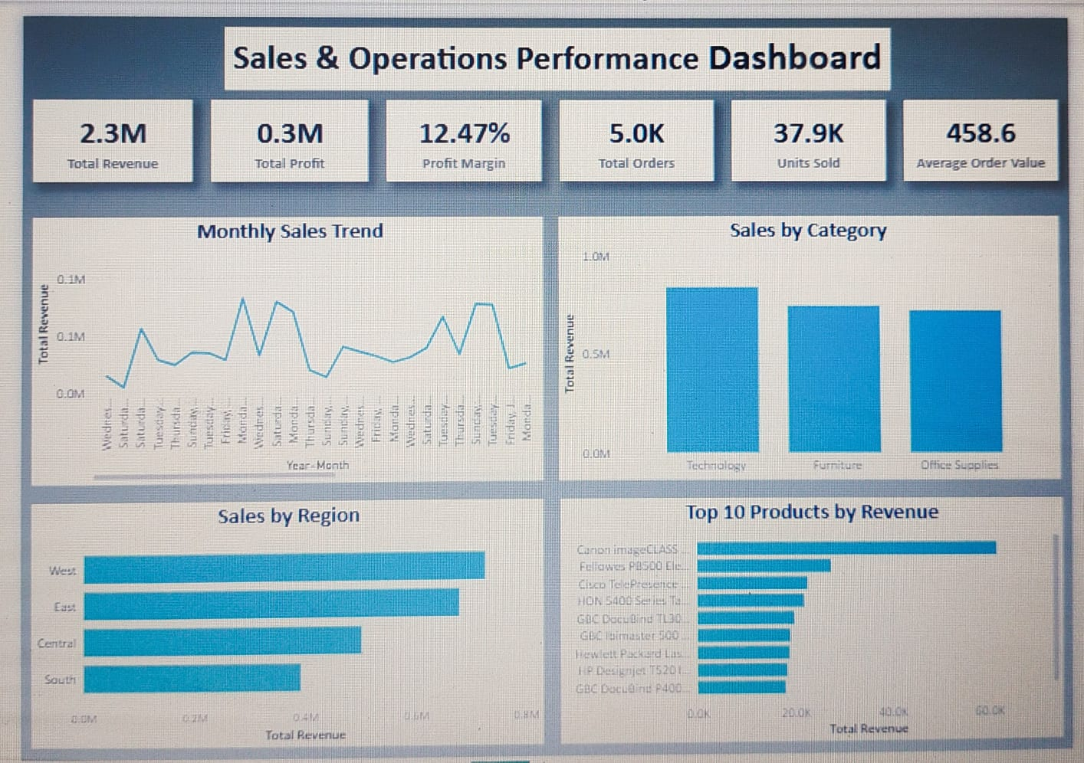
Interactive Dashboard
View Interactive Dashboard

Slide 6
Key Insights
Sales are generally stronger in late-year months.
Technology & Furniture are major revenue contributors.
Regional sales performance is uneven.
High revenue does not always mean high profit.
Some products require profitability review.

Slide 7
Recommendations
1. Plan Ahead
Prepare inventory before peak sales periods.
2. Focus on Winners
Prioritize successful products and categories.
3. Weak Areas
Investigate lower-performing regions.
4. Protect Profit
Review pricing, discounts and costs of low-margin products.

Slide 8
Case Study — From Data to Action
Problem
Limited visibility
Analysis
Excel + Power BI
Finding
Sales & profitability vary
Action
Better planning + profitable growth
Result: A clear, data-driven view of sales and operations.

Slide 9
THANK YOU
Presented by: Musab

